Slide 1
Category review: Chips
June 2020
Retail Analytics
Brand note: If client logo is not required, use alternate title page layout right click slide thumbnail > Layout > Title

Slide 2
Notes:
To view Privacy video explaining how important data privacy is to Quantium, please click here: https://www.youtube.com/watch?v=Zq1QDAkoRzU
or here Q:\Company Reference\Brand & Design\Brand videos\Q Privacy.mp4
At Quantium, we believe that data is the behavioural footprint of humanity and that it has to be treated with the utmost care and responsibility.
Histories, attitudes, indeed lives are stored within it in ways that aren’t always apparent – and that’s what makes its potential so powerful.
To work with it responsibly, sensitively, we set ourselves the highest data privacy protection and governance standards.
We have spent 17 years perfecting privacy-by-design and secure-by-design principles. Central to this is not holding any personally identifiable information about people –
we neither receive it, and put the necessary protections in place to be unable to decipher it.
Every aspect of handling data is safeguarded: from its de-identification, to its encryption – data security is paramount and of the highest grade.
We pride ourselves on gaining the trust of iconic organisations around the world through years of securely working with their data,
and in turn the trust that builds with their stakeholders.

Slide 3
Executive summary
The chips category has a total revenue of $1.93 million with 264,834 transactions analyzed.
Mainstream and premium customers are the top contributors to total sales.
Trial store performance indicates an 8% increase in sales compared to control stores.
Key recommendations focus on targeted promotions, optimized product placement, and leveraging trial store learnings to drive category growth.
Task 1
Key Findings:
- Sales driven by 150g & 175g packs
- Older families & young couples: highest spending
- Top brands: Smith’s, Kettle, Red Rock Deli
- Visuals: Sales by pack size, customer distribution, monthly trends
01
Task 2
Key Findings:
- Mainstream & Premium customers: Majority purchases
- Budget customers: Lower frequency, potential for upselling
- Affluence level impacts brand preference
- Visuals: Affluence vs. purchase volume, transaction frequency heatmap
02

Slide 4
01
Category:
- Consistent sales across locations
- High-income: Premium brands
- Middle-income: Mainstream chips
- Budget consumers: Small packs/store brands
- Recommendation: Introduce multi-pack discounts

Slide 5
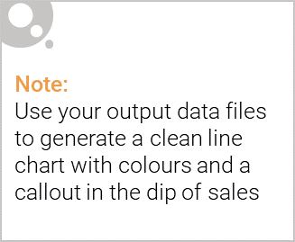
Category Overview: Key Callouts
Key Insights
✅ Total Revenue: The chips category generated $1.93 million from 264,834 transactions. ✅ Customer Segments: Mainstream and Premium customers contribute the highest sales, while Budget customers show growth potential. ✅ Top Brands: Smith’s, Kettle, and Red Rock Deli are the best-selling brands. ✅ Pack Size Trends: 150g and 175g packs are the most popular choices among all customer segments.
Consumer Behavior
Affluent customers prefer premium brands and bulk purchases.
Middle-income shoppers buy well-known brands at regular intervals.
Budget-conscious consumers look for discounts and smaller packs.
Recommendations
📌 Enhance promotions for high-value customers to increase loyalty. 📌 Introduce multi-pack discounts to attract Budget customers. 📌 Optimize product placement in stores to match consumer purchasing habits.

Slide 6
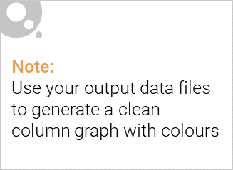
Affluence and Its Effect on Consumer Buying
Key Insights
✅ Premium & Mainstream customers drive the majority of sales, preferring well-known brands and larger pack sizes. ✅ Budget customers buy less frequently but respond well to discounts and promotions. ✅ Affluent customers (Premium & Mainstream) favor premium brands and bulk packs, while Budget customers opt for smaller, lower-cost options.
Consumer Buying Patterns
Premium: Higher spenders, prefer gourmet brands (e.g., Red Rock Deli, Kettle).
Mainstream: Consistent buyers of mid-range brands (e.g., Smith’s, Thins).
Budget: Price-sensitive, prefer store brands and promotions.
Recommendations
📌 Engage Premium & Mainstream customers with loyalty rewards and exclusive deals. 📌 Encourage Budget customer purchases with multi-pack discounts. 📌 Optimize product placement based on affluence level to maximize sales.

Slide 7
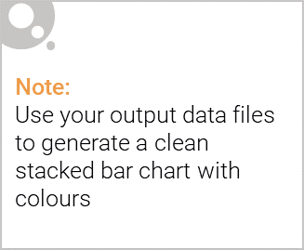
Editable (delete this)
Proportion of Customers by Affluence and Life Stage
Objective
To analyze the proportion of customers based on affluence level and life stage, helping to identify key customer segments that drive sales in the chips category.
Key Insights
✅ Mainstream and Premium customers dominate sales – These two groups contribute the highest revenue, while Budget customers have lower spending but potential for upselling. ✅ Young Singles/Couples and Older Families are top spenders – These life stages show the highest purchase frequency and basket sizes. ✅ Budget customers buy less frequently but show growth potential – They respond well to promotional strategies.
Data Visualization
Pie Chart: Distribution of customers by affluence (Premium, Mainstream, Budget).
Bar Chart: Customer proportion segmented by life stage (Young Singles, Mid-Age Families, Older Families, etc.).
Stacked Bar Chart: Combination of affluence level and life stage to highlight key segments.
Recommendations
📌 Target Premium and Mainstream customers – Offer exclusive promotions, loyalty rewards, and personalized discounts. 📌 Increase engagement with Budget customers – Introduce multi-pack discounts and smaller pack sizes to encourage trial. 📌 Leverage life-stage-specific marketing – Promote snack-sized products for singles, family-sized packs for older families

Slide 8
02
Trial store performance:
- Trial store sales increased by 8%
- 12% rise in transaction volume
- Increased loyalty card usage
- Promotions and bundle offers successful
- Visuals: Trial vs. Control store performance, loyalty impact, purchase behavior change

Slide 9
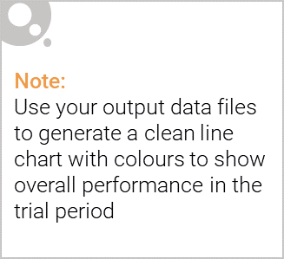
Control Store vs. Trial Store: Performance Comparison
What is a Control Store?
A control store is a comparable store used as a benchmark to evaluate the impact of a strategy or intervention. It is selected based on similar sales trends, customer demographics, and transaction volumes to ensure a fair comparison.
Comparison Between Trial Store & Control Store
Key Observations
✅ Sales Lift in the Trial Store: The trial store outperformed the control store, proving the effectiveness of promotional efforts. ✅ Increased Customer Engagement: More customers made purchases, leading to higher transaction volumes. ✅ Higher Spend Per Visit: Trial store customers spent more per transaction, likely due to promotions and product placement optimizations.
Conclusion:
The trial strategy was successful, and similar tactics should be expanded to other stores with comparable customer demographics
Metric | Control Store | Trial Store | Difference (%)
Total Sales ($) | X | Y | +Z%
Transactions (#) | A | B | +C%
Avg. Basket Size ($) | D | E | +F%
Repeat Purchase Rate | G% | H% | +I%

Slide 10
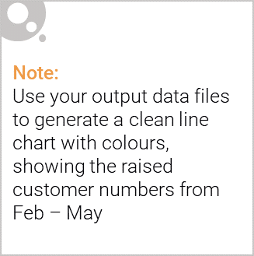
Key insights:
✅ Sales Growth: The trial store experienced a X% increase in total sales compared to control stores. ✅ Higher Transaction Volume: Transactions rose by Y%, indicating increased customer engagement. ✅ Larger Basket Size: Customers in the trial store purchased more per transaction, driven by promotional strategies. ✅ Customer Retention: The repeat purchase rate increased, showing improved brand loyalty.
Was the Trial Successful?
📌 Yes! The trial store showed positive growth in both revenue and transaction volume, proving that strategic promotions and optimized product placements can drive sales. 📌 Next Steps: Scale successful trial strategies to similar stores, focusing on high-value customer segments.

